Slide 1
Intro to Forensic Science

Slide 2
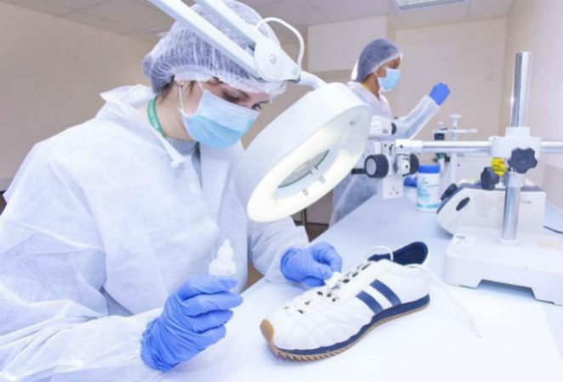
What is Forensic Science?
Forensic science is the science used by the courts to support criminal or civil investigations

Slide 3
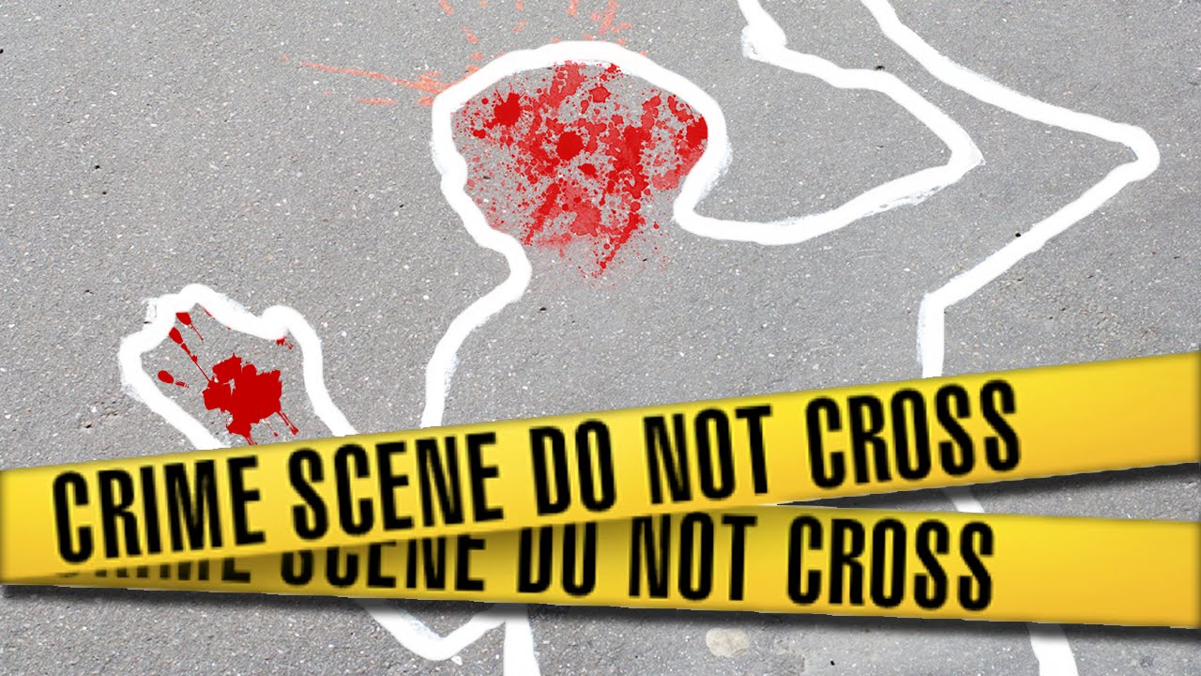
Crime Scene
Any physical location in which a crime has occurred

Slide 4
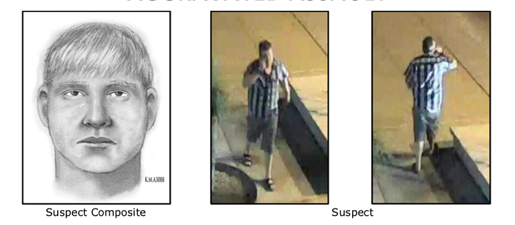
Suspect
Any person thought to be capable of committing the crime

Slide 5
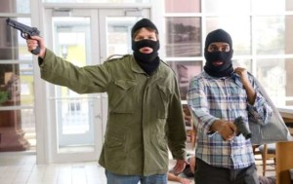
Accomplice
A person associated with someone suspected of committing a crime

Slide 6
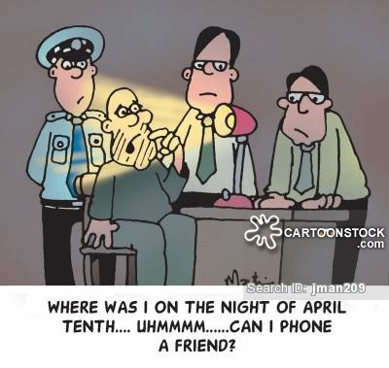
Alibi
A statement of where the suspect was at the time of the crime

Slide 7
Types of Evidence
Testimonial
Physical
Trace Evidence

Slide 8
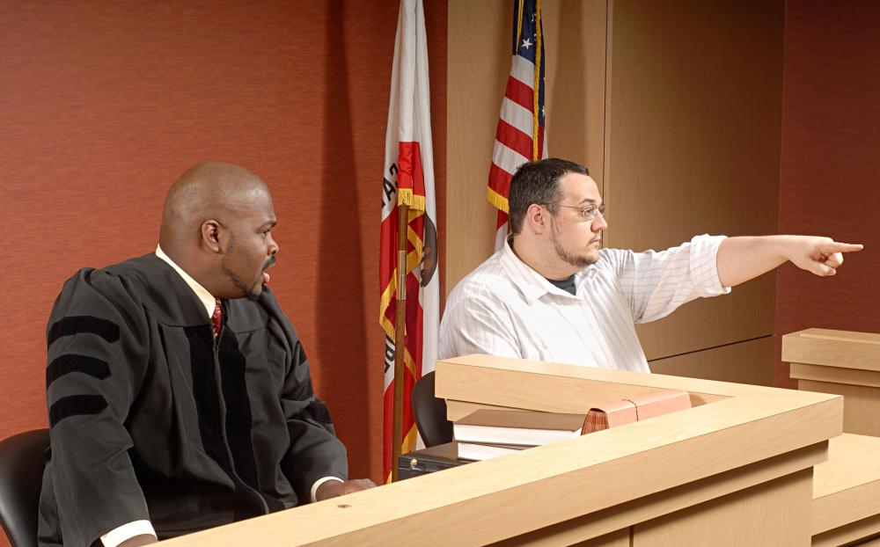
Testimonial
Oral or written statements by people who witnessed an event

Slide 9
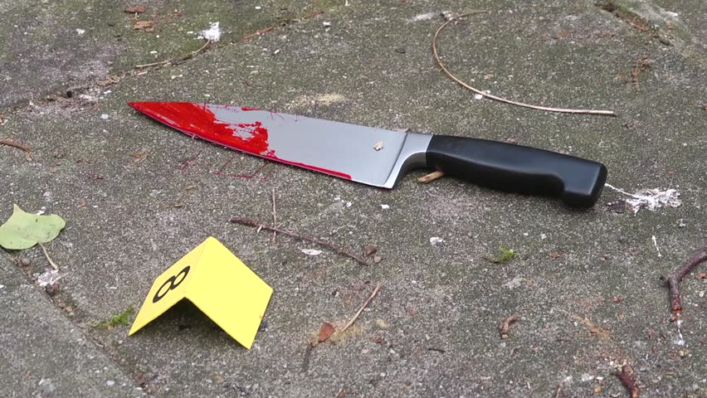
Physical Evidence
Any material items present at the crime scene, on victim or in suspects possession

Slide 10
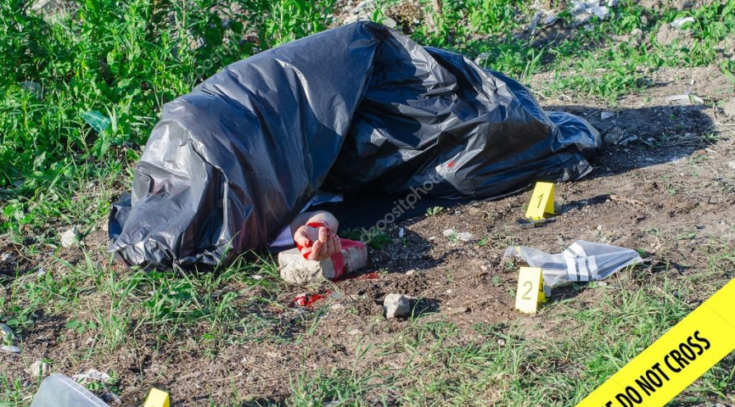
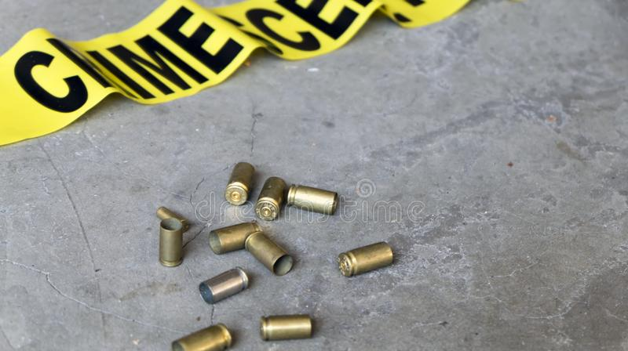
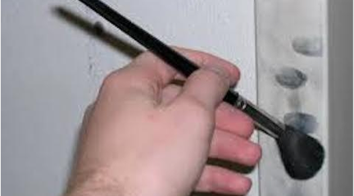
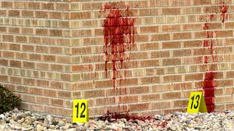
Examples of Physical Evidence
Corpse
Bullets/Casings
Fingerprints
Blood

Slide 11
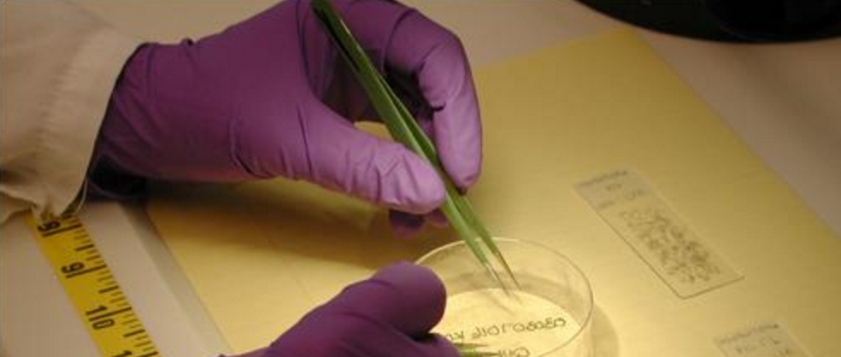
Trace Evidence
Physical evidence that is found in small but measurable amounts

Slide 12
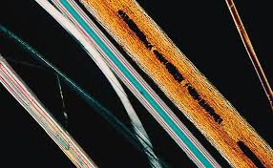
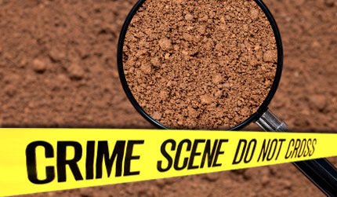
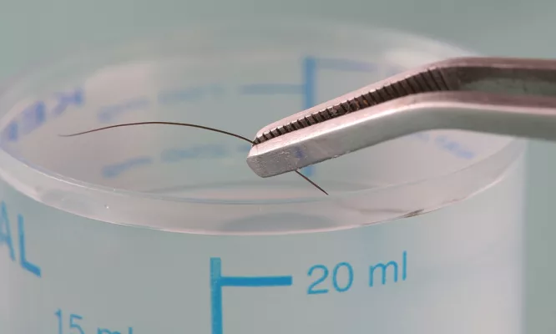
Examples of Trace Evidence
Fibers
Pollen
Soil
Hair

Slide 13
YouTube Crime Scene Investigation

Slide 14
Stop Here

